Slide 1
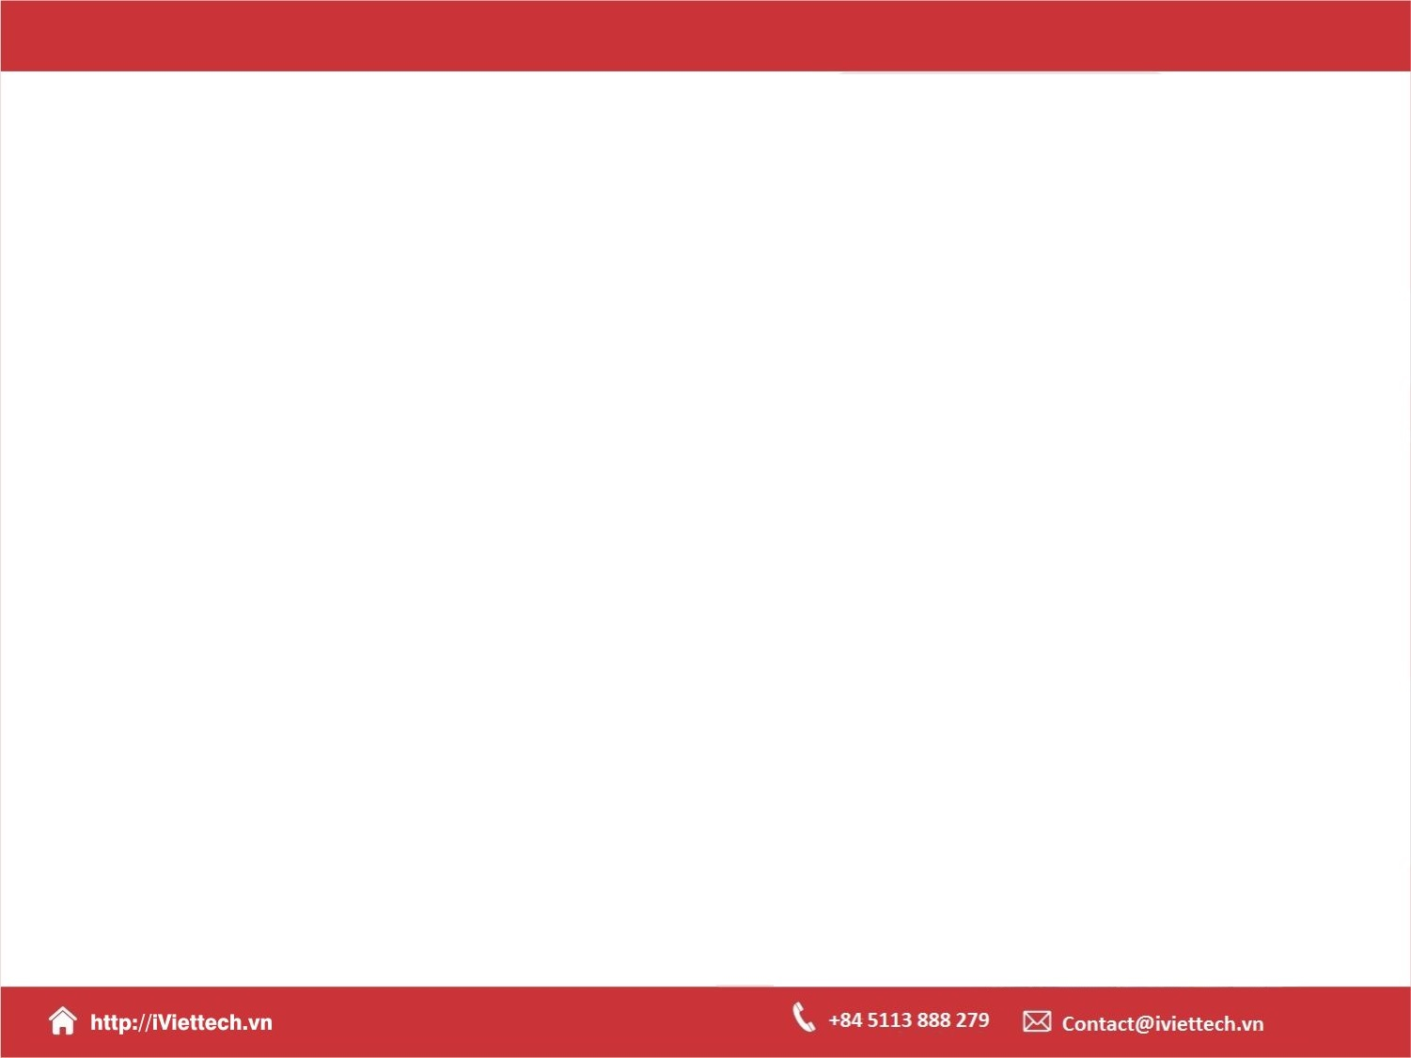
Chapter 10 –S11
How to use Grid Layout for page layout and RWD
Notes:
Session: Ghi số thứ tự session trong môn học
Session Name: ghi tên của session sẽ dạy

Slide 2
Objectives
Getting started with Grid Layout
How to define the grid areas for elements
A responsive web page that uses grid
Common page layouts that use grid

Slide 3
Getting started with Grid Layout
In this chapter, you’ll learn how to use Grid Layout, or Grid to layout content In both rows and columns. This makes it easier to develop web pages with more complex layouts.
Notes:
Session: Ghi số thứ tự session trong môn học
Session Name: ghi tên của session sẽ dạy

Slide 4
An introduction to Grid Layout
Notes:
Session: Ghi số thứ tự session trong môn học
Session Name: ghi tên của session sẽ dạy

Slide 5
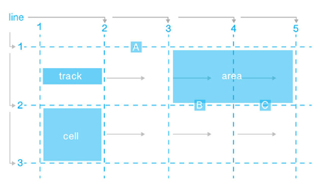
An introduction to Grid Layout
A grid consists of a grid container with one or more columns and rows.
A grid tracks, a grid cell, a grid area.

Slide 6
How to create a basic grid
You create a grid container by setting the display property of a block element to either grid or inline-grid.
Then, use the grid-template-rows, grid-template-columns properties to specify the size of row and column tracks in grid.

Slide 7
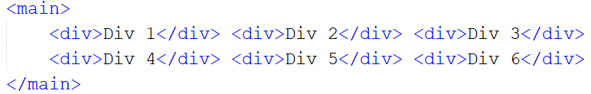
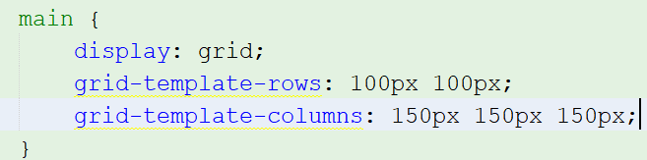
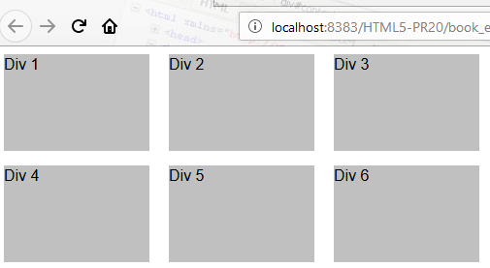
How to create a basic grid

Slide 8
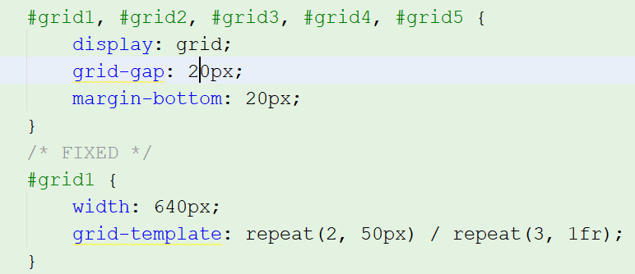
How to set the size of grid track
Define the size of a grid track using any of measure, including the fr unit.
Use repeat(repeat, track-list), minmax(min, max) functions.

Slide 9
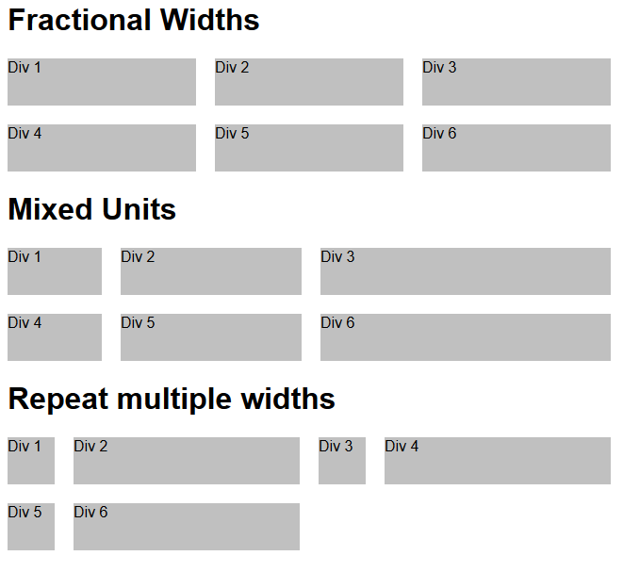
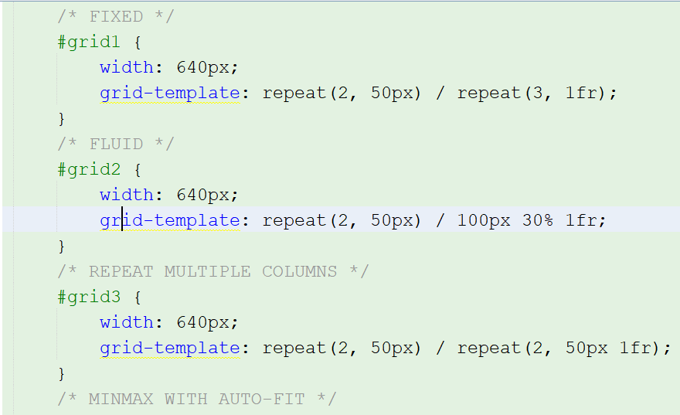
How to set the size of grid track

Slide 10
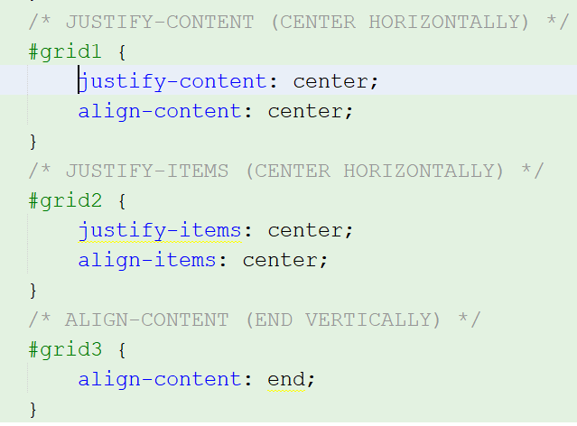
How to align grid items and grid tracks
Use the properties for horizontal alignment
Justify-content, Justify-items, Justify-self
Use the properties for vertical alignment
align-content, align-items, align-self

Slide 11
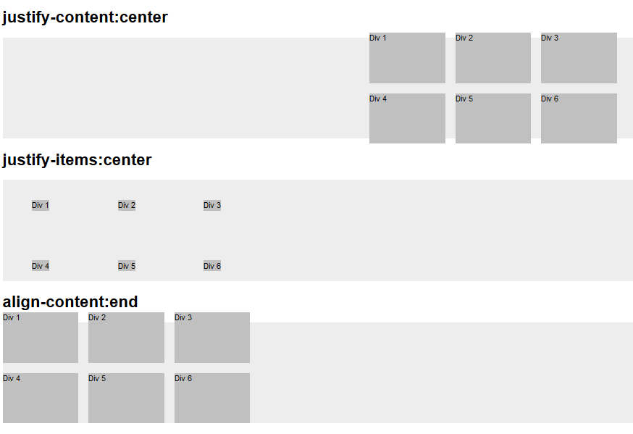
How to align grid items and grid tracks

Slide 12
How to define the grid areas for elements
Notes:
Session: Ghi số thứ tự session trong môn học
Session Name: ghi tên của session sẽ dạy

Slide 13
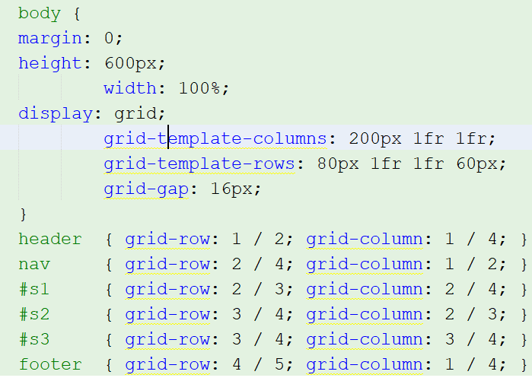
How to use numbered lines
To position grid items using the numbered lines, you use grid-row, grid-column properties.

Slide 14
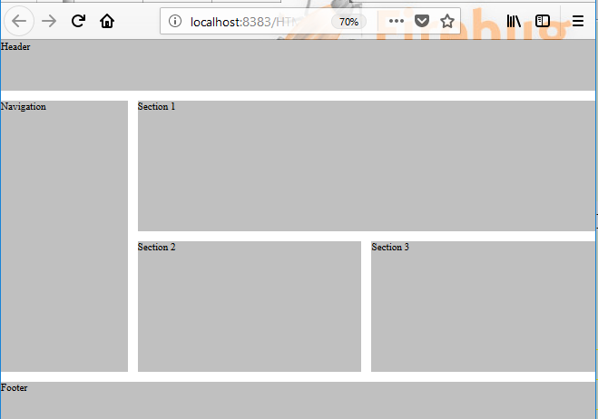
How to use numbered lines

Slide 15
How to use named lines
To name a grid line, you code the name within brackets on the grid-template-columns, grid-template-rows, and grid-template properties.
You code these names in the position in which they occur in the gird, and you separate two or more names for the same line with spaces.

Slide 16
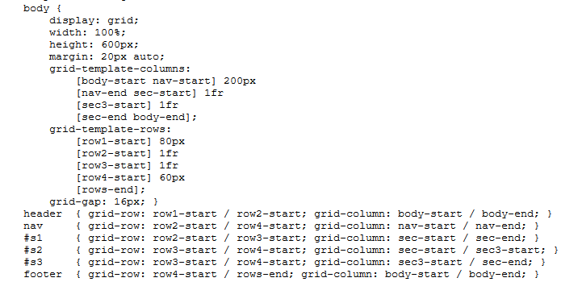
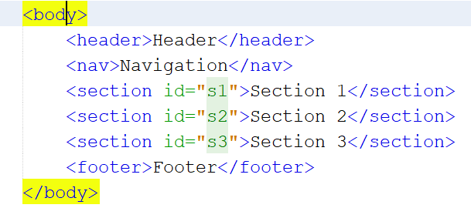
How to use named lines
Example : 06_named_lines.html

Slide 17
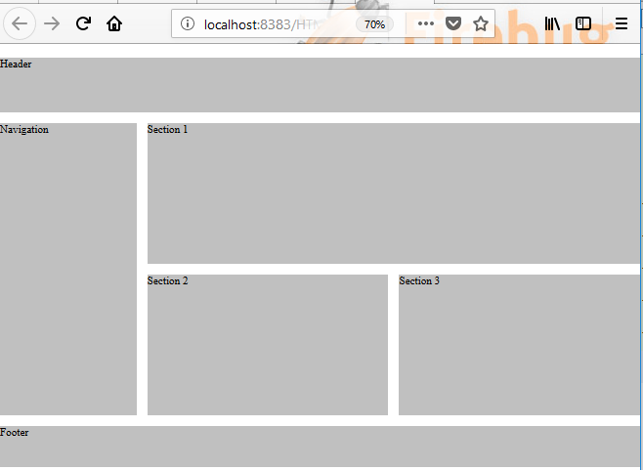
How to use named lines

Slide 18
How to use template areas
To assign names to the cells in a grid, you code the grid-template-areas for container element.
To place an element within a grid area, you use the grid-area property

Slide 19
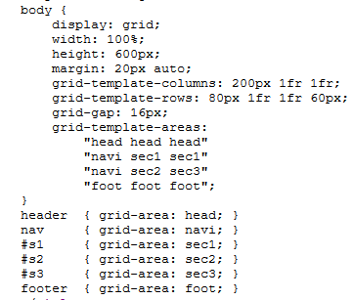
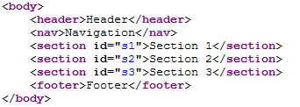
How to use template areas

Slide 20
How to use the 12 columns grid concept
The 12-column grid concept is a popular layout concept that you can apply in grid layout using numbered lines.
To create a 12 column grid, you can the repeat() function to define 12 proportional columns.

Slide 21
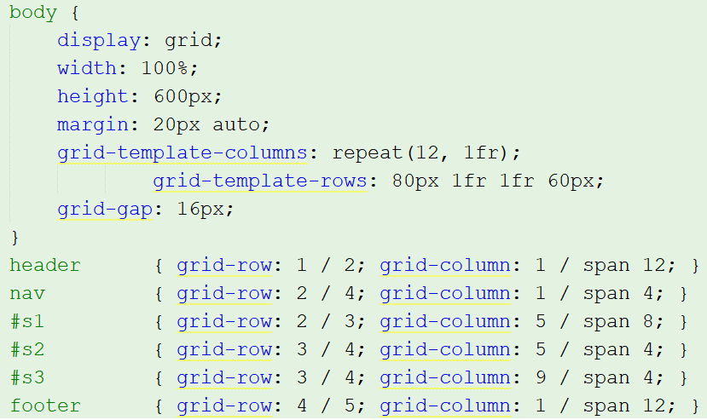
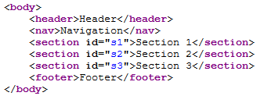
How to use the 12 columns grid concept

Slide 22
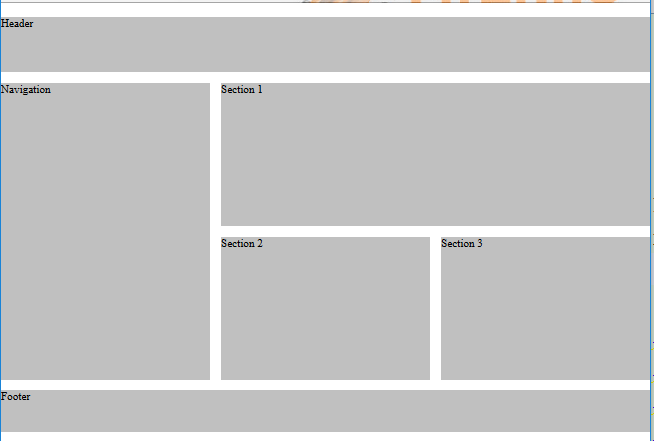
How to use the 12 columns grid concept

Slide 23
A responsive web page that uses grid
Notes:
Session: Ghi số thứ tự session trong môn học
Session Name: ghi tên của session sẽ dạy

Slide 24
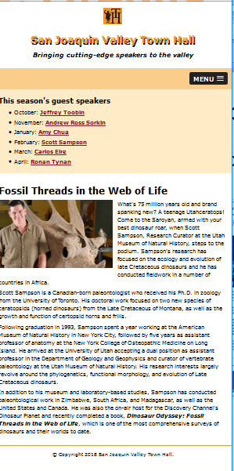
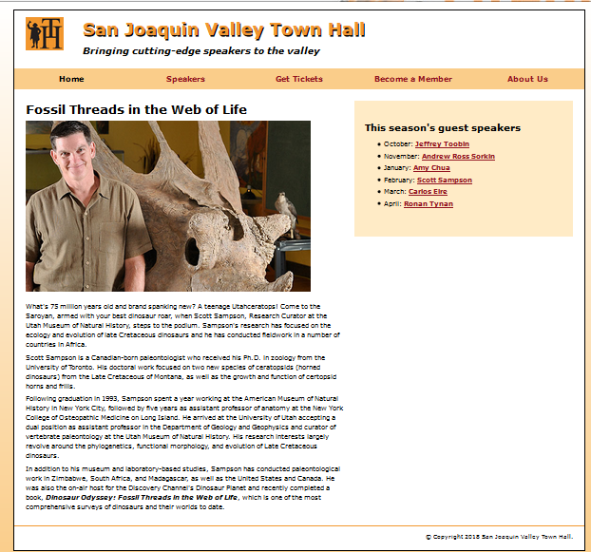
The design of web page
A speaker page in desktop and tablet layout. (pages 372- 375)

Slide 25
The HTML for the structural elements
Notes:
Session: Ghi số thứ tự session trong môn học
Session Name: ghi tên của session sẽ dạy

Slide 26
Common page layouts that use grid
Notes:
Session: Ghi số thứ tự session trong môn học
Session Name: ghi tên của session sẽ dạy

Slide 27
Common page layouts that use grid
You will see three more common page layout that you can implement using grid.
The headline and gallery layout
The fixed sidebar layout
The advanced grid layout

Slide 28
The advanced grid layout
The headline and gallery layout is frequently used to display a series of images.
The sidebar in the fixed sidebar layout is displayed vertically and is fixed to the side of the window.

Slide 29
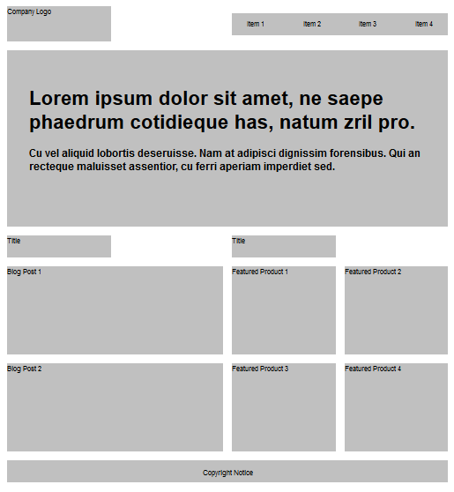
The advanced grid layout

Slide 30
Summary
In this chapter, you learned how to use Grid Layout to layout the structural elements of a page in rows and columns.
Although you can use Grid Layout for almost any page, it is most useful when you’re developing more complex page layout.
Notes:
Tóm tắt lại nội dung đã học

